Slide 1

Researching Public Companiess

Slide 2
The Oklahoma Department of Securities Invest Ed® program has provided this information as a service to investors. Invest Ed does not recommend any particular investment strategy or plan, any type of product, or any securities professional over another. No part of Invest Ed shall be taken as investment and/or legal advice.

Slide 3
Ready to do some research? Start here:
EDGAR database on the SEC website
Investor relations page on the company website
Notes:
Researching public companies
There are two places that we can visit to learn more about a publicly traded company.
1. The company’s investor relations page
2. EDGAR (Electronic Data Gathering, Analysis, and Retrieval) is an online public database from the U.S. Securities and Exchange Commission (SEC).

Slide 4
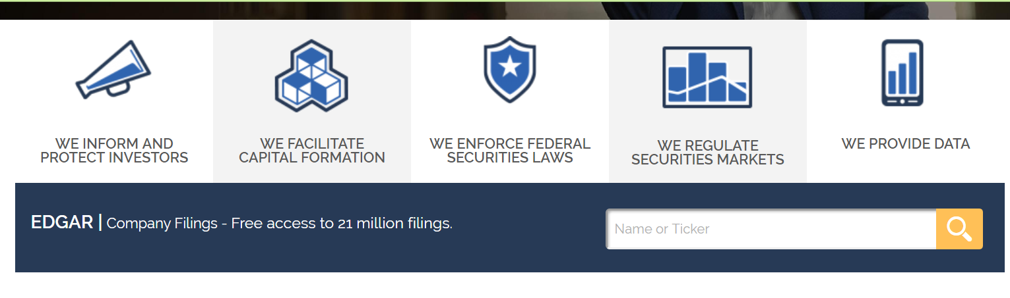
EDGAR
www.sec.gov
Notes:
A publicly traded company must file certain documents with the SEC on a regular basis. These documents provide investors with information on the company’s financial condition, the management’s discussion of the business, and various corporate announcements.

Slide 5
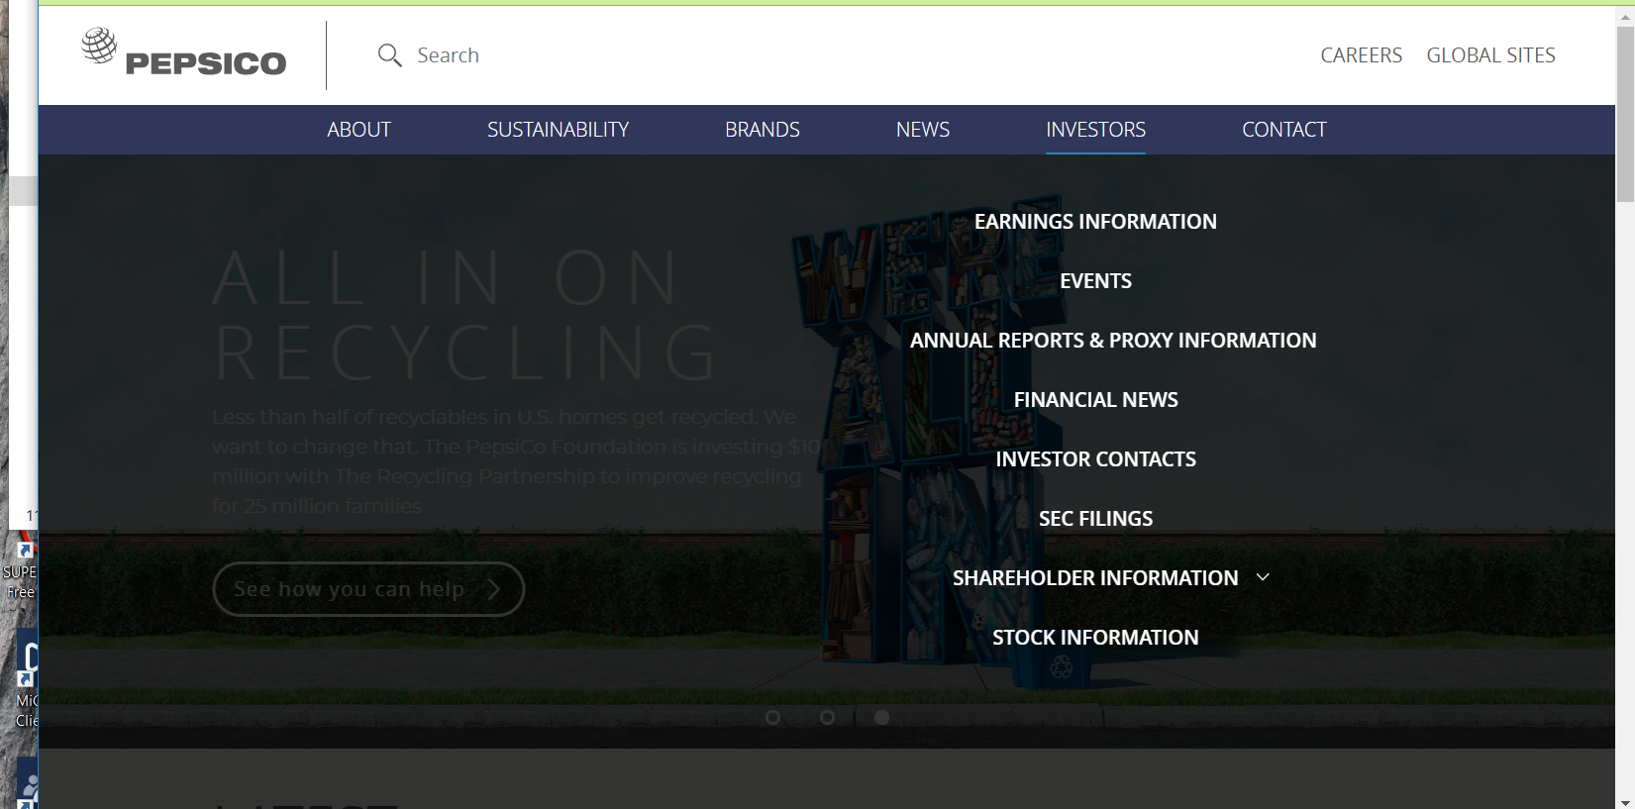
Most companies have an investor relation page- Below is Pepsico
Notes:
Most public companies have an investor relations page that provides the SEC filings, along with other information such as company news and recent presentations. This is a screenshot from Pepsico.
The investor relations page is designed to share news, corporate announcements, and links to financial filings. This page is an excellent way for an investor to learn about a public company.
Not all companies present this information in the same way on their corporate website.

Slide 6
Financial Filings
10-Q
10-K
First 3 quarters
Last quarter
Notes:
Financial filings. A public company must file a financial report (or financial filing) each quarter. At the end of each of the first three quarters of the year, the firm files a form “10-Q” . At the end of the last quarter of the year, the firm files a “10-K”, also known as the “annual report”, since it provides the 4th quarter information and the entire year’s financial results.
Financial filings include accounting information (such as the income statement and earnings per share), a discussion by management about the most recent quarter and the business environment, and disclosures of various business risks. Investors should read financial filings thoroughly to understand the company’s business operations. Think of the 10-Q (quarterly report) as the company’s periodic report card and the 10-K (annual report) as the final grade for the year.

Slide 7
Insider Transactions
Who is an insider?
Anyone who owns more than 10% of a company’s stock, or who is a member of the board of directors, or any officer in the company, like a CFO or COO.
Insiders are allowed to buy and sell shares in their own companies during certain windows of time.
Generally, insider sales or purchases of stock must be reported to the SEC.
Notes:
Generally, insider sales or purchases of stock must be reported to the SEC.
Who is an insider? For SEC filing purposes, an insider is anyone who owns more than 10% of a company’s stock, or who is a member of the board of directors, or any officer in the company, like a CFO (Chief Financial Officer) or COO (Chief Operating Officer).
Insiders are allowed to buy and sell shares in their own companies, but only during certain windows of time when there is no recent or upcoming announcement of material news. It is illegal to trade on “non-public material information”. Material information is news that a reasonable investor would want to have in making an informed decision about the stock. Insiders cannot trade in their own shares before a major announcement when they would have an advantage of inside information. This is known as “insider trading”.

Slide 8
What Can We Learn From Insider Transactions?
When management buys stock, or has a large amount of stock, their own financial interests are aligned with the shareholders’ interest.
An officer’s sale of a large amount of his stock holdings may not show confidence in the company’s financial future.
There are 3 forms that companies file with SEC concerning insiders: forms 3, 4, & 5 available on the SEC website.
Notes:
What can we learn from insider transactions?
When management buys stock, or has a large amount of stock, their own financial interests are aligned with the shareholders’ interest. Usually this results in management decisions that enhance shareholder value. An officer’s sale of a large amount of his stock holdings may not show confidence in the company’s financial future.
There are three forms that companies file with the SEC concerning insiders:
(Show image of forms 3, 4, 5 on SEC website)
Form 3: discloses the name (and number of shares) of anyone who owns more than 10% of the shares, or is a corporate officer or director.
Form 4 and Form 5: disclosures of transactions (buys or sells) and how the shares were acquired (grants from the company or purchased in the open market).

Slide 9
What is “insider trading”?
It is illegal to trade on “non-public material information”. Material information is news that a reasonable investor would want to have in making an informed decision about the stock. Insiders cannot trade in their own shares before a major announcement when they would have an advantage of inside information. This is known as “insider trading”.
Notes:
It is illegal to trade on “non-public material information”. Material information is news that a reasonable investor would want to have in making an informed decision about the stock. Insiders cannot trade in their own shares before a major announcement when they would have an advantage of inside information. This is known as “insider trading”.
Insider trading can also involve those that are not considered insiders of the company. For example, anyone who trades on insider information obtained from friends or family on the inside of a company can be engaged in insider trading.

Slide 10
Prospectus
Number of shares to be sold & amount of money to be raised
Use of proceeds
Insiders selling their stock
Explanation of the company’s business
Risk factors
Historical financial information
Primary stockholders & how many shares they own
Management’s background & experience
Commissions to be paid to those selling the shares
When a company wants to sell new securities it files a registration statement containing a prospectus. The prospectus contains very important information
Notes:
Prospectus. (insert picture of prospectus) When a company wants to sell new securities to investors, it files a registration statement that contains a prospectus. Inside a prospectus you will find very important information such as:
Number of shares to be sold & amount of money to be raised
Use of proceeds
Insiders selling their stock
Explanation of the company’s business
5. Risk factors
6. Historical financial information
7. Primary stockholders and how many shares they own
8. Management’s background and experience
9. Commissions to be paid to those selling the shares

Slide 11
Corporate governance
This is a section of the investor relations page that reveals the ways a public company protects the rights of its shareholders.
Notes:
Corporate governance. This section of the investor relations page reveals the ways a public company protects the rights of its shareholders. Form DEF 14A or DEFA14A (if revised) comes out once a year. This “proxy” document discloses the names and backgrounds of the members of the board of directors and also discusses the executive salaries and bonuses each year. The company will also share its Code of Business Conduct and Ethics guidelines. The proxy outlines the ways to vote on the candidates for the Board of Directors. This Board represents the shareholders’ interests inside the company.

Slide 12
News and Press Releases
The company normally releases official news to the public through its investor relations website.
External finance-based websites have reports and news stories about companies, but these can be biased and are often worthless. Please use credible news sources when investigating a company. The company is required to file a form 8-K with the SEC through its EDGAR database with any material news.
Rather than using the investor relations page, you can go directly to the SEC and enter the ticker symbol in the EDGAR database.

Slide 13
Summary of forms filed on EDGAR
10-K, 10-Q: the annual and quarterly reports
8-K: news releases
3, 4, or 5: Insider holdings and transactions
DEF 14A : Proxy
S-1, 424B3: security offerings for registration of new shares and the relevant prospectuses

Slide 14
RED FLAG
When a company delays its filing of quarterly or annual reports, something may be amiss.
Late filings by public companies may indicate poor stock and operating performance.
Notes:
On EDGAR, the late filings will be marked in front with “NT” (Not Timely).

Slide 15
TERMS
EDGAR
10-K
10-Q
8-K
annual report
prospectus
insider
insider trading
CFO
COO
proxy document

